Slide 1
EVP Process - ERONET

Slide 2
EVP Process at ERO-Net
All Self-verified forms form NVSP, Mobile App.
Generate Verification check list
Remaining Elector, who has not verified themselves online
BLO Field verification
Operator Login
ERO Marked the Elector as Verified Elector on UNPER
Verification report Submitted on ERONET along with form reference number (if any)
All details found correct on verification
After Approval, Elector is marked as verified
Form is digitized for further processing
Appropriate Form collected by BLO
Detail not found correct

Slide 3
USER : EVP Home page For Operator
Select Part
Generate Verification Checklist
Enter BLO Verification Report
Generate Report for ERO
Report on Feedback on Polling Station
ERO Home Page

Slide 4
Operator Verification Checklist generation
EVP Checklist PART NO: 76
Sr No | EPIC No. | Name | Relation Name | Source | Process
 |  |  |  | NVSP | Generate verification list
 |  |  |  | Mobile App | Generate verification list
 |  |  |  | Not Self-Verified | Generate verification list
 |  |  |  | Not Self-Verified | Generate verification list
 |  |  |  | Not Self-Verified | Generate verification list
 |  |  |  | Not Self-Verified | Generate verification list
 |  |  |  | NVSP | Generate verification list
 |  |  |  | NVSP | Generate verification list
 |  |  |  | NVSP | Generated
 |  |  |  | NVSP | Generated
 |  |  |  | Mobile App | Generated
 |  |  |  | Not Self-Verified | Generated
 |  |  |  | Mobile App | Generated
 |  |  |  | Mobile App | Generated
 |  |  |  | Mobile App | Generate verification list
 |  |  |  | Mobile App | Generated
 |  |  |  | Not Self Verified | Generated
 |  |  |  | NVSP | Generated

Slide 5
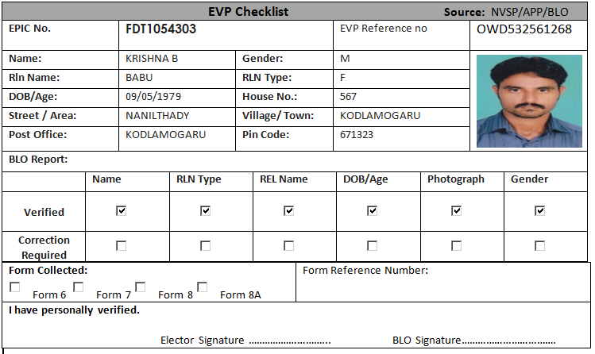
Verification Checklist Format

Slide 6
Verification Checklist Submission (Operator Level)
EVP Checklist Entry process PART NO: 67
Sr No | Name | Relation Name | Source | Process
 |  |  | NVSP | Submit Checklist
 |  |  | Mobile App | Submit Checklist
 |  |  | Not Self-Verified | Submit Checklist
 |  |  | Not Self-Verified | Submit Checklist
 |  |  | Not Self-Verified | Submit Checklist
 |  |  | Not Self-Verified | Submitted
 |  |  | NVSP | Submitted
 |  |  | NVSP | Submitted
 |  |  | NVSP | Submitted
 |  |  | NVSP | Submitted
 |  |  | Mobile App | Submitted
 |  |  | Not Self-Verified | Submit Checklist
 |  |  | Mobile App | Submit Checklist
 |  |  | Mobile App | Submit Checklist
 |  |  | Mobile App | Submit Checklist
 |  |  | Mobile App | Submit Checklist
 |  |  | Not Self Verified | Submit Checklist
 |  |  | NVSP | Submit Checklist

Slide 7
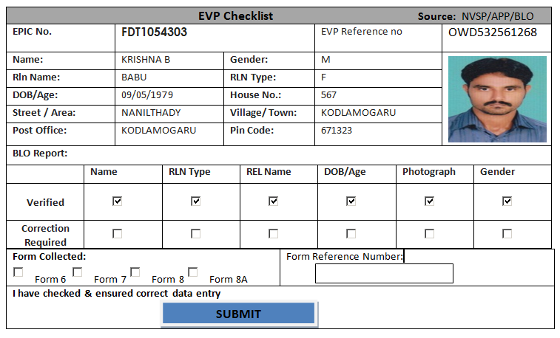
Verification Checklist Submission

Slide 8
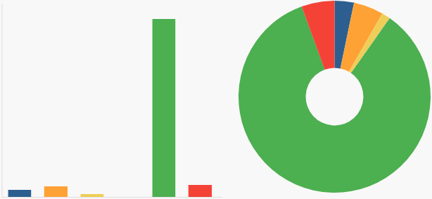
HIGHLIGHTS
Total Elector’s
Number of request received form NVSP
Number of Request received form Mobile App
Number of Request received form NGSP
Elector Pending for verification
Elector verified by BLO
Elector detail collected & verified by BLO
No. Of form collected
Form 6
Form 6A
Form 7
Form 8
Form 8A
USER : EVP Home page For ERO Login
EVP Reports
Process Verified Report
Part Wise Report
EVP Verified List

Slide 9
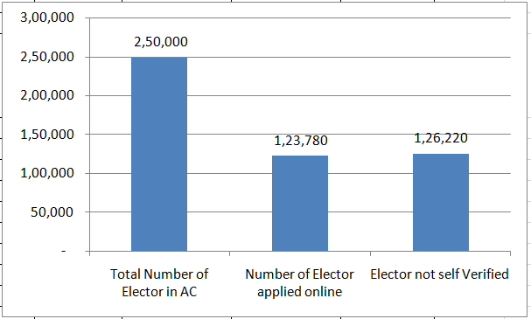
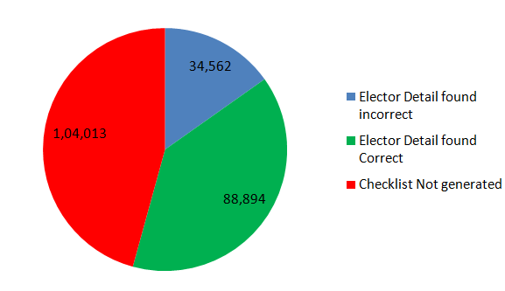
ERO EVP Dashboard ( AC Wise)
Ac Name | Total Number of Elector in AC | Number of Elector applied online | Elector not self Verified | Checklist Generated | Clecklist Submitted | Elector Detail found incorrect | Elector Detail found Correct
Ichchapuram | 2,50,000 | 1,23,780 | 1,26,220 | 1,45,987 | 1,23,456 | 34,562 | 88,894

Slide 10
Polling Station Suggestions report
Polling Station Number | Total Elector | Natural Barrier in reaching Polling Station | Polling station far away | PS Building Infrastructure not Adequate | PS in Private Building | No issue in polling Station
43 | 1365 | 12 | 34 | 23 | 33 | 98

Slide 11
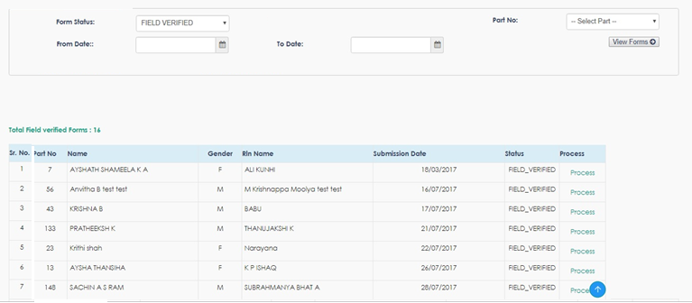
ERO EVP Verification screen

Slide 12
ERO EVP verified list
Verified List
PART NO | Sr No | Name | Relation Name | Source | Status
1 |  |  |  | NVSP | Verified
1 |  |  |  | Mobile App | Verified
1 |  |  |  | Not Self-Verified | Verified
1 |  |  |  | Not Self-Verified | Verified
1 |  |  |  | Not Self-Verified | Verified
1 |  |  |  | Not Self-Verified | Verified
1 |  |  |  | NVSP | Verified
1 |  |  |  | NVSP | Verified
1 |  |  |  | NVSP | Verified
1 |  |  |  | NVSP | Verified
1 |  |  |  | Mobile App | Verified
1 |  |  |  | Not Self-Verified | Verified
1 |  |  |  | Mobile App | Verified
1 |  |  |  | Mobile App | Verified
1 |  |  |  | Mobile App | Verified
1 |  |  |  | Mobile App | Verified
1 |  |  |  | Not Self Verified | Verified
1 |  |  |  | NVSP | Verified

Slide 13
ERO EVP List( Part Wise)
Part Number | Part Name | Total Number of Elector in Part | Number of Elector applied online | Elector not self Verified | Checklist Generated | Clecklist Submitted | Elector Detail found incorrect | Elector Detail found Correct
1 | Muchendra
2 | Kedaripuram
3 | MPUP SCHOOL, KEDARIPURAM (ADDL BUILDING 6 & 7TH CL
4 | Purushottapuram
5 | Purushottapuram
6 | Aminsahebpeta
7 | Mandapalli
8 | MANDAPALLI
9 | Mandapalli
10 | MANDAPALLI
11 | Balakrishnapuram
12 | Munibadra
7 | Mandapalli
8 | MANDAPALLI
9 | Mandapalli
10 | MANDAPALLI
11 | Balakrishnapuram
12 | Munibadra

Slide 14
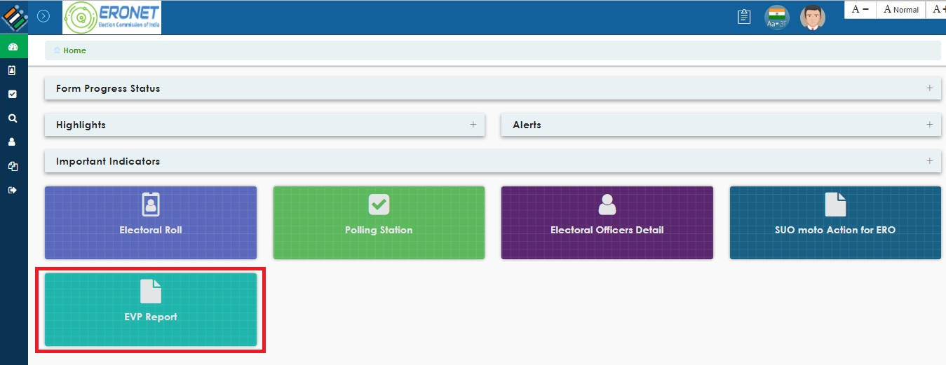
DEO/CEO/ ECI EVP Dashboard

Slide 15
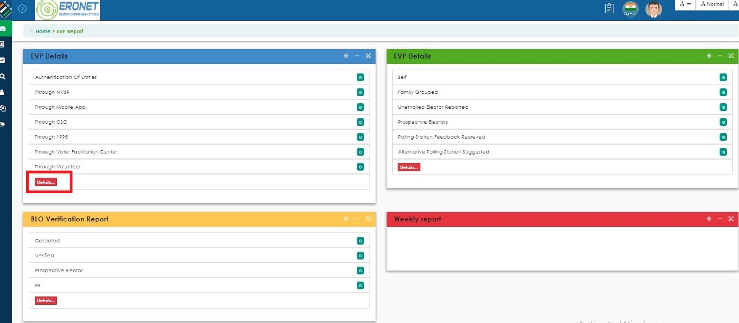
DEO/CEO/ ECI EVP Dashboard

Slide 16
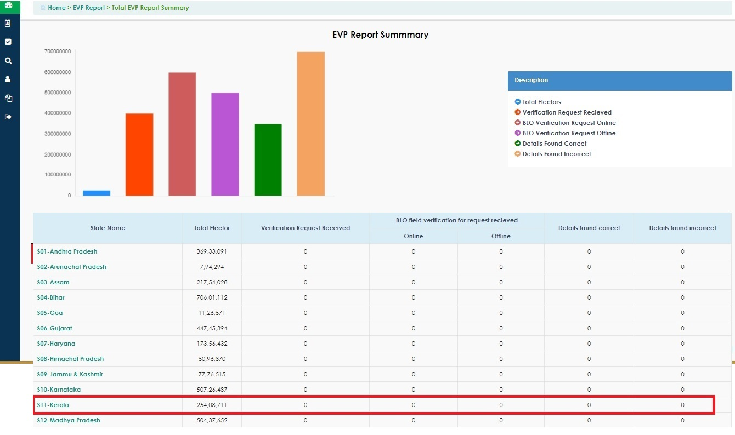
DEO/CEO/ ECI EVP Dashboard

Slide 17
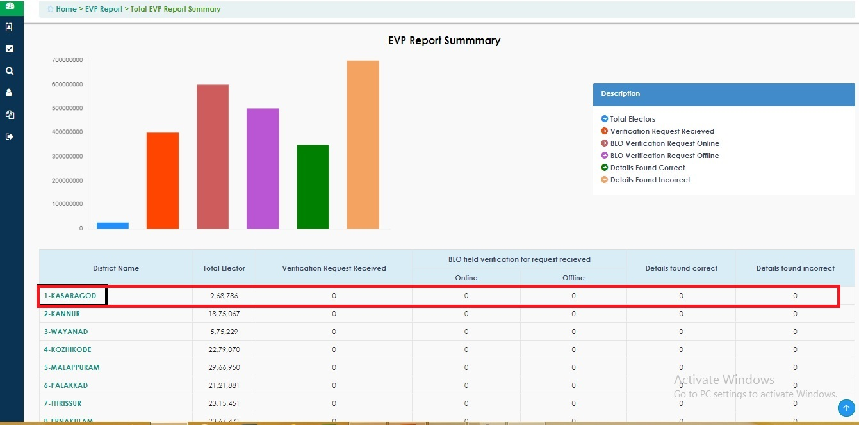
DEO/CEO/ ECI EVP Dashboard

Slide 18
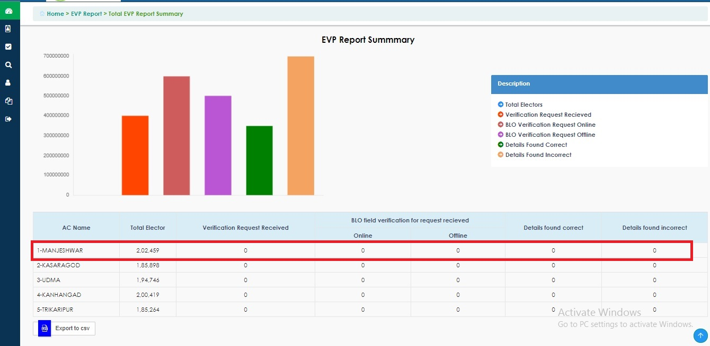
DEO/CEO/ ECI EVP Dashboard

Slide 19
Thanks

